Slide 1


SYSTEMS THINKING
Mapping the Business Mind
Visualizing the Architecture of Decisions and Data
WEEK 3
01 / 30

Slide 2
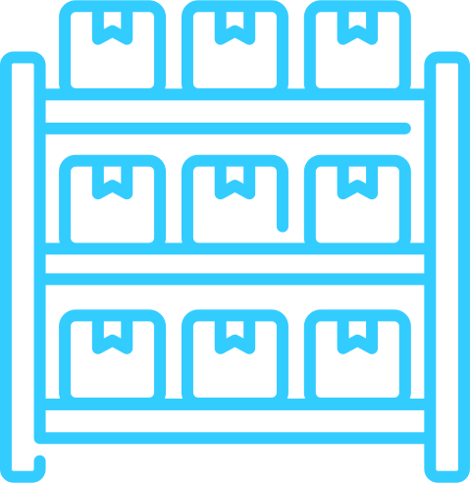




SYSTEMS THINKING
A Business Is a System
Inventory
Staff
Customer
Payment
Delivery
What we have
in stock right now
Who executes
every task
Who drives
every demand signal
Where value
is exchanged
How the product
reaches the end
Break any one of these parts and the entire system fails -- not just one department.
02 / 30

Slide 3
Why Map the Flow?
If you don't know the process, you don't know the data
Most data errors happen when the process changes but the report does not
Mapping reveals the Blind Spots where data gets lost or corrupted
A flowchart is a contract, it defines what should happen at every step
You cannot fix what you cannot see
03 / 30

Slide 4
Linear vs. Non-Linear Thinking
Linear Thinking
Systems Thinking
Step A leads to Step B
Step A leads to B... but what if C?
One path, one outcome
Multiple paths, multiple outcomes
Easy to model, dangerous in reality
Accounts for every exception
Ignores exceptions and failures
Analysts must think in branches
04 / 30

Slide 5
DATA INTEGRITY
The Data Lineage
Where was this number born?
Who touched it between the source and your spreadsheet?
Every hand it passes through is a chance for error or manipulation
How did it get into your report?
Understanding lineage is the first step in ensuring data integrity
Based on Gateway to BA: trust is earned by tracing the origin
05 / 30

Slide 6
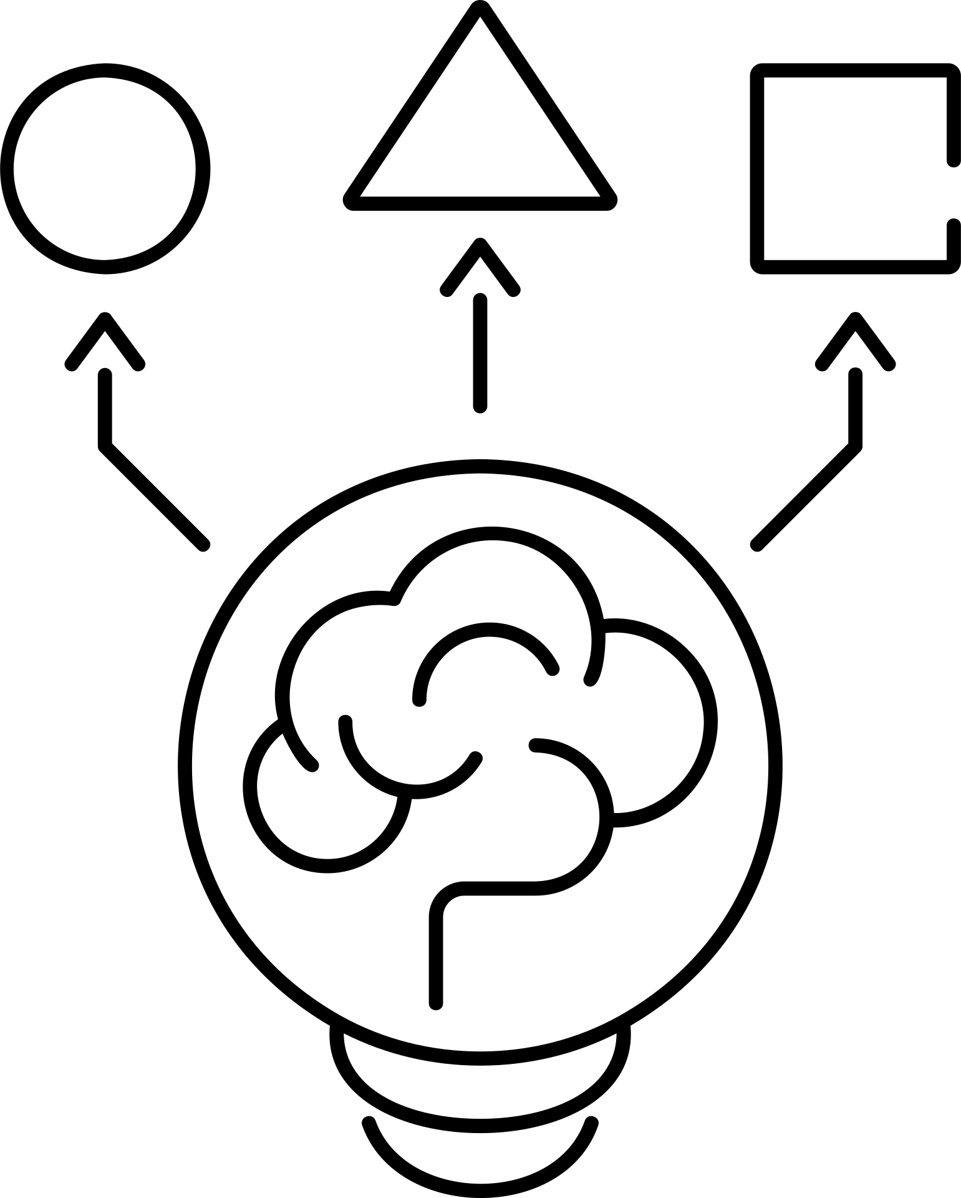
SECTION 2
The Language
of Logic
Flowchart symbols every analyst must know
06 / 30

Slide 7

ISO STANDARD SYMBOLS
The Universal Flowchart Language
Oval
Rectangle
Diamond
Parallelogram
Terminator
Start / End
of the process
Process / Task
An action that
must be performed
Decision
Yes / No branch
The logic gate
Input / Output
Data entering or
leaving the system
Using these correctly means any professional in the world can read your logic without a translator.
07 / 30

Slide 8
LOGIC SYMBOLS
The Decision Diamond
This is where the business rules live, the heart of analytics
Is the order over $50? -> Yes: Free shipping / No: Add $5 shipping
Every diamond in your flowchart becomes an IF statement in Excel or Python
A business process with no diamonds is just a checklist
A business process with too many diamonds is a bureaucracy
08 / 30

Slide 9
ITERATION
The Loop. Repeating Until Done.
A loop repeats a process until a condition is satisfied
Customer Support: Is the ticket resolved? -> No: back to agent -> Yes: close
Without a loop, a process either ends too early or never escalates
Every loop must have an exit condition, or you create an infinite loop
In data: refreshing a dashboard until the data loads is a loop
09 / 30

Slide 10
LOGIC GATES
Logic Gates: AND vs. OR
AND Gate
OR Gate
Both conditions must be TRUE
Either condition can be TRUE
High Credit Score AND Steady Job
Pay by Credit Card OR Pay by Cash
= Loan Approved
= Transaction Accepted
Stricter -- narrows the outcome
More flexible -- widens the outcome
10 / 30

Slide 11
CASE STUDY
The Pizza Shop Challenge
Customer orders pepperoni pizza. Map the decision logic.
[?]
[?]
[X]
Check Stock
Suggest Alt
Cancel Order
Is pepperoni
available?
Yes -> Make pizza
No -> Next step
Offer mushrooms.
Customer accepts?
Yes -> Make pizza
No -> Next step
No substitute
accepted.
Cancel order.
Notify customer.
Breaking Bad: Season 3, Episode 2
11 / 30

Slide 12
Dead Ends and Infinite Loops
“
A customer stuck on a phone menu with no 'Talk to a Human' option is not a system failure.
It is a logic failure.
12 / 30

Slide 13
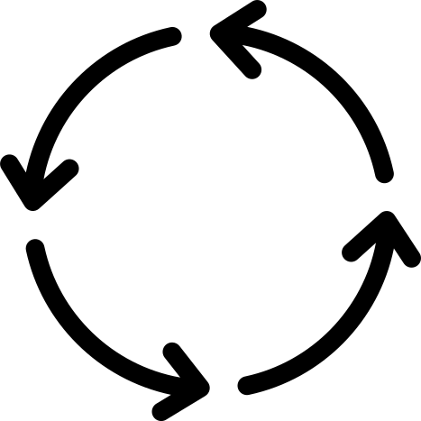
SECTION 3
Business Process
Mapping
Translating real operations into readable logic
13 / 30

Slide 14


PROCESS MAPPING
The 'As-Is' vs. The 'To-Be'
As-Is
To-Be
How we do it right now
How analytics will optimize it
Often messy, undocumented
Streamlined, measurable
Full of workarounds
Bottlenecks removed
The honest starting point
You cannot get here without mapping As-Is first
14 / 30

Slide 15
CASE STUDY
Loan Approval: The Logic Map
1
2
3
Submit
Score
Route
>
>
Applicant submits
completed form
to the system
System checks
Credit Score
against threshold
< 600: Auto Reject
> 600: Manual Review
  Mapping this reveals where the "Human-in-the-Loop" is required.
15 / 30

Slide 16
DIAGNOSTIC POWER
Bottlenecks, Where the Flow Slows Down
100 applicants enter the top of the funnel per day
The Interview box can only handle 5 per day
The bottleneck is Interview, not hiring, not sourcing
Every system has at least one bottleneck, your job is to find it
Mapping the flow makes bottlenecks visible before they become crises
16 / 30

Slide 17
TWO FLOWS
Data Flow vs. Process Flow
Process Flow
Data Flow
What a person does
What the system does
e.g. Handing a receipt
e.g. Storing Transaction ID
Physical actions and decisions
Silent, automatic, invisible
Visible to the customer
The analyst bridges both worlds
17 / 30

Slide 18
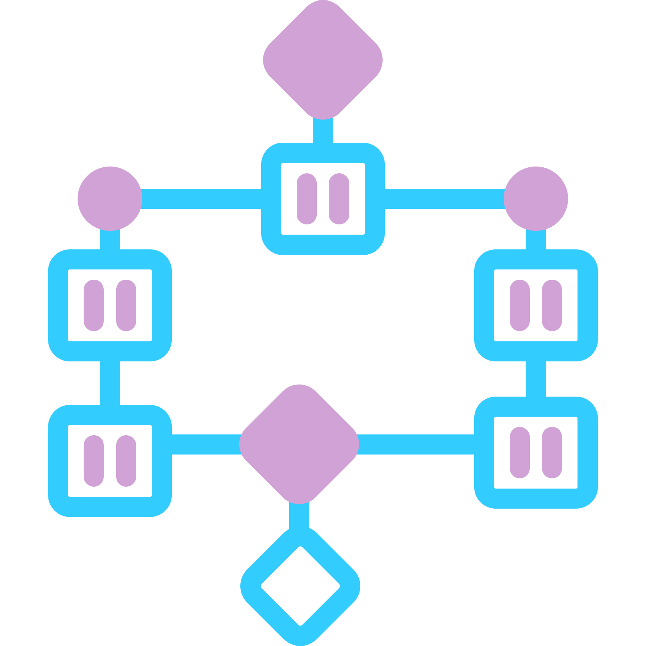
SWIMLANES
Swimlane Diagrams
Divide the flowchart by WHO owns each task: Sales, Finance, Customer
Swimlanes make Handoffs visible -- and handoffs are where most errors occur
When responsibility crosses a lane boundary, risk increases sharply
Each lane is accountable for its own steps
Rule: if more than 15 boxes, break into sub-processes -- clarity is king
18 / 30

Slide 19
QUALITY CHECK
Validation — Walking the Flow
Take one real transaction and walk it through your flowchart step by step
Can it complete successfully without getting stuck or looping forever?
If it gets stuck, your logic has a gap before you ever write one line of code
Test the exception paths, not just the happy path
An airline with a logic error that allows double-booking costs millions per incident
19 / 30

Slide 20

STAKES
$0
is the cost of fixing a logic error on paper
The same error in production, after data has flowed through it, costs thousands. Map first, build second.
20 / 30

Slide 21

SECTION 4
Tooling &
The Human Touch
Where logic becomes visual and ethics become real
21 / 30

Slide 22



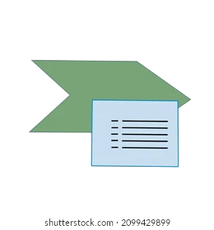
TOOLS
Tools for Building Flow Maps
Lucidchart
Miro
Visio
Excel SmartArt
Cloud-based,
collaborative,
shares easily
Infinite canvas,
great for workshops
and brainstorming
Microsoft standard,
enterprise-grade,
full ISO symbol set
Keeps your logic
next to your data.
No extra software.
A napkin and a pen are still the best starting point. Tools only formalize what your mind already mapped.
22 / 30

Slide 23
SECTION 4 • VISUAL DESIGN
Alignment & Aesthetics in Flowcharts
Use consistent color coding: Processes = Blue, Decisions = Yellow, Terminators = Red
Align all shapes to a grid, misaligned boxes signal sloppy thinking
Visual consistency reduces the cognitive load on the viewer by up to 40%
One font. Two sizes. No gradients. Clarity over decoration.
If someone can't read your chart in 30 seconds, redraw it
23 / 30

Slide 24
DIAGNOSTIC CONNECTION
The 'Systemic' Why
The numbers dropped, but why? Go back to the flowchart
Look for the Decision node that is rejecting too many records
A misconfigured rule in one diamond can silently corrupt every downstream number
Descriptive tells you what fell. The flowchart tells you where it fell from.
Analytics without process knowledge is pattern-matching in the dark
24 / 30

Slide 25
HUMAN TOUCH.....AGAIN!
The Gray Area
Machines Handle
Humans Handle
+
The Yes / No
The Maybe
Binary decisions.
Clear thresholds.
Fast, scalable,
consistent.
Edge cases.
Context & nuance.
Every flow must have
an Escalate to Human path.
25 / 30

Slide 26
ETHICS
The Ethics of Automated Logic
An AI automatically rejects resumes based on a single keyword
If your logic is biased, your automation runs that bias at industrial scale
One flawed decision diamond rejects thousands before a human notices
Automation amplifies, both accuracy and error, both fairness and discrimination
Every automated flow must have an audit trail and a human override path
26 / 30

Slide 27
Soft Skill: CRITICAL THINKING
“
For every change you suggest to a process, ask:
What happens to the next person in the chain?
27 / 30

Slide 28
CRITICAL THINKING
Spotting AI-Built Flows
If a flowchart looks perfect with zero exceptions, a machine built it
Real business processes have noise -- edge cases, workarounds, legacy rules
The AI optimizes for the clean path; reality is full of dirty paths
Your value as an analyst: knowing which exceptions matter
Test it: walk a difficult real case through the 'perfect' flow and see where it breaks
28 / 30

Slide 29
SUMMARY
What We Covered This Week
Systems Thinking: every business is a network of interacting parts
Flowchart Symbols: the universal ISO language of logic
Process Mapping: As-Is to To-Be, bottlenecks, swimlanes, validation
Human Touch: machines handle Yes/No, humans handle Maybe, ethics handles everything
29 / 30

Slide 30

Let's Talk.
Logic is the beginning of wisdom,
not the end.
Lab: 'Customer Refund Loop' assignment, map the full refund process.
Next week: Data Visualization.
30 / 30

